Slide 1
FINANCE AND SUPPLY CHAIN ANALYTICS
SQL PROJECT
Presented by IMRAN

Slide 2
CONTENTS
About AtliQ and Problem Statement
Project overview
Tables, Views, Functions and Stored Procedures
2021 Sales Report for Croma categorized by product
Monthly Total Gross Sales Report for Croma
Annual GROSS Sales Overview for Croma India
Key Markets and Prime Customers in the Financial Year -2021'
% of Net Sales contributed by Customers in the Market Share
% of Market Share by Region based on Net Sales
Supply Chain Forecast Quantity
SQL

Slide 3
About ATLIQ AND PROBLEM STATEMENT
AtliQ Hardware, a prominent company renowned for its global presence, specializes in manufacturing PCs, printers, mice, and computers.
The increased size of Excel files has resulted in performance issues, causing delays and inefficiencies. AtliQ Hardware has initiated a project to address this challenge, forming a team of data analysts. Leveraging MySQL as their database management system, the team aims to extract valuable insights from the data. These insights will empower the company to improve decision-making and streamline operations, leading to enhanced overall performance.
PRESENTED BY IMRAN

Slide 4
PROJECT OVERVIEW
This project aims to analyze and derive valuable insights from the provided database, encompassing sales, products, customers, and regions data for Atliq Hardware. The objective is to address specific inquiries regarding sales reports, market analysis, customer behavior, and supply chain forecasting
PRESENTED BY IMRAN

Slide 5
TABLES
A table is a database object that stores data in rows and columns, where each row represents a unique record, and each column represents a specific attribute or field.
Tables hold the actual data and are the primary structure for storing information in relational databases.
FUNCTIONS
A view is a virtual table created by querying data from one or more tables. It doesn’t store data itself; instead, it dynamically retrieves data from underlying tables each time the view is accessed. Views provide a way to simplify complex queries, enhance security by limiting data access, and present data in a specific format without altering the underlying tables.
VIEWS
Functions in SQL are reusable routines that return a single value or a table. They can perform calculations, transformations, or return specific sets of data. Functions allow you to encapsulate logic that can be reused across various queries, which is useful for complex calculations or data transformations.
STORED PROCEDURES
A stored procedure is a precompiled set of one or more SQL statements that can be executed as a single unit. Stored procedures can include variables, control-of-flow statements, and can accept input parameters and return multiple values. Stored procedures are used to perform repetitive tasks, implement business logic, and enhance database performance by reducing the need for multiple SQL queries.
PRESENTED BY IMRAN

Slide 6
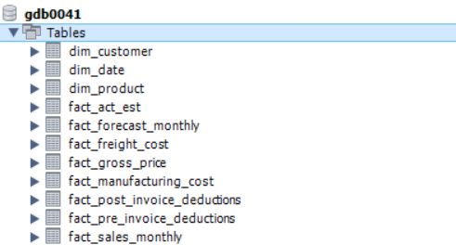
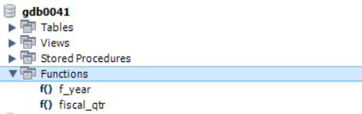
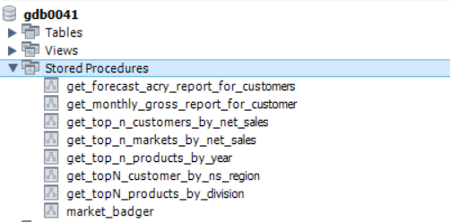
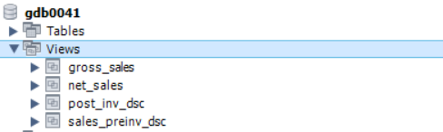
Tables
FUNCTIONS
STORED PROCEDURES
VIEWS
PRESENTED BY IMRAN

Slide 7
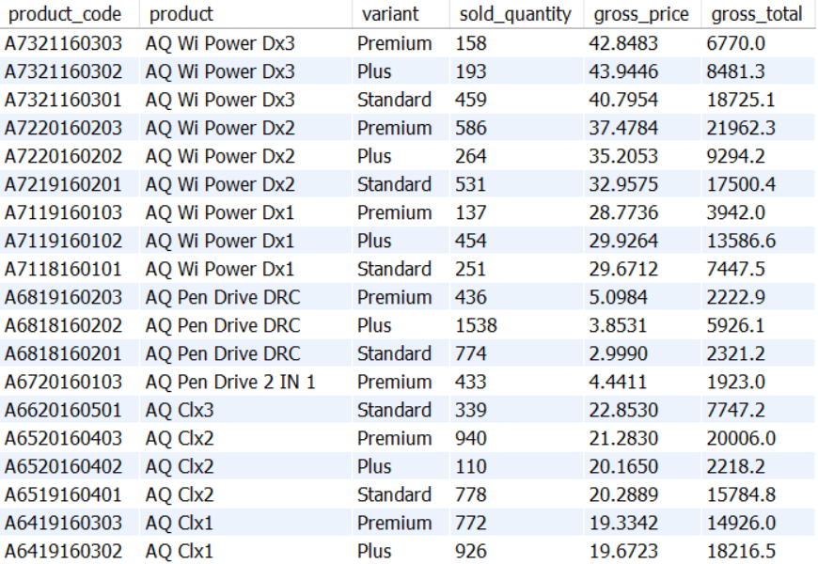
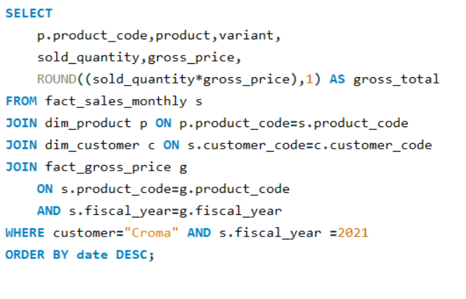
2021 Sales report for CROMA categorised by product
SQL Query
Output
PRESENTED BY IMRAN

Slide 8
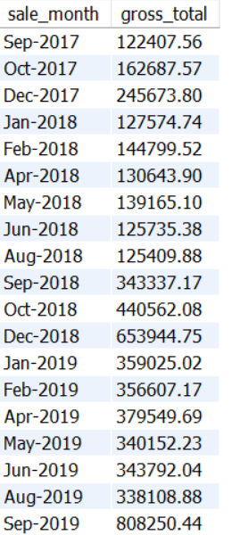
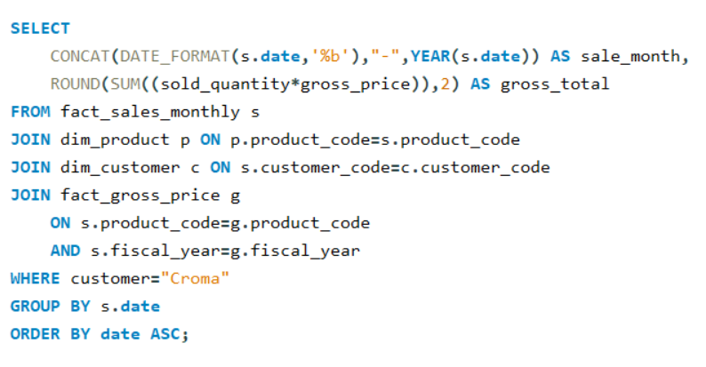
MONTHLY total gross sales report for CROMA
Output
SQL Query
PRESENTED BY IMRAN

Slide 9
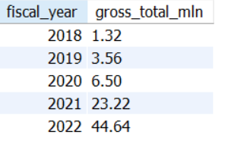
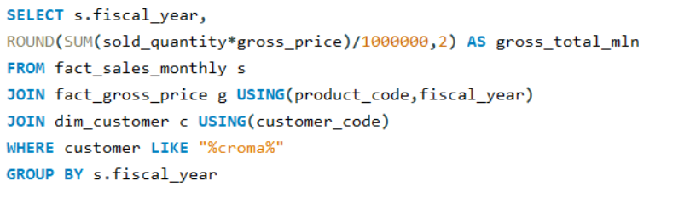
Annual gross sales report for CROMA
SQL Query
Output
PRESENTED BY IMRAN

Slide 10
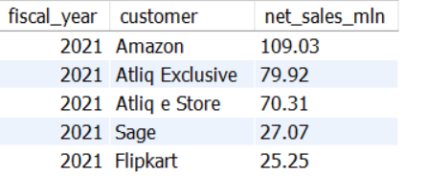
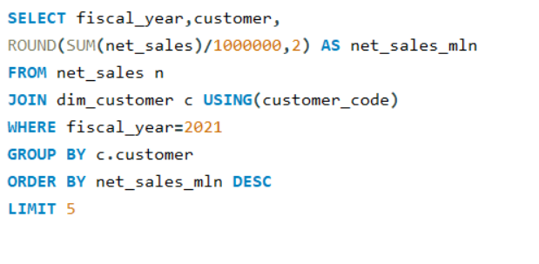
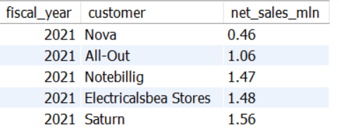
REPORT OF PRIME customers in 2021 by net sales
SQL Query
Output
Top 5
Bottom 5
PRESENTED BY IMRAN

Slide 11
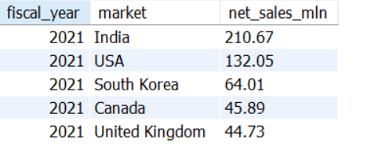
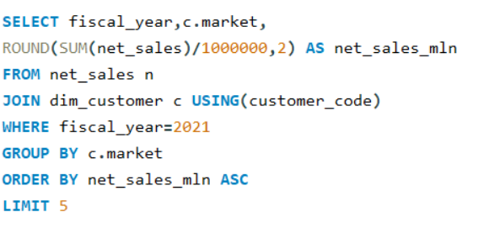
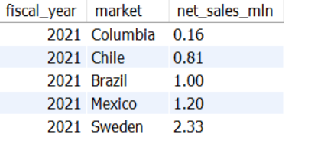
REPORT OF KEY MARKETS in 2021 by net sales
SQL Query
Output
Top 5
Bottom 5
PRESENTED BY IMRAN

Slide 12
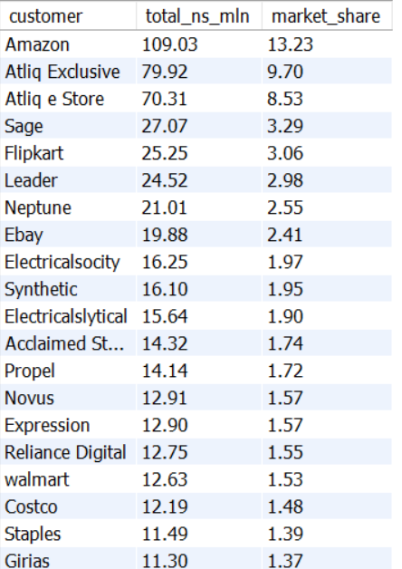
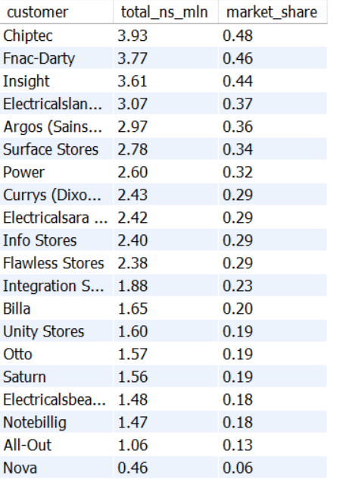
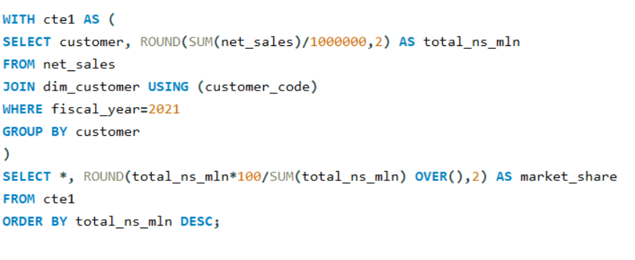
% OF MARKET SHARE Contributed by CUSTOMERS BASED ON NET SALES
SQL Query
Output
PRESENTED BY IMRAN

Slide 13
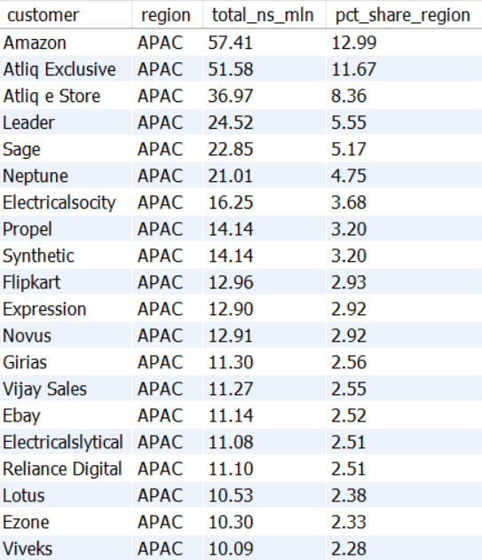
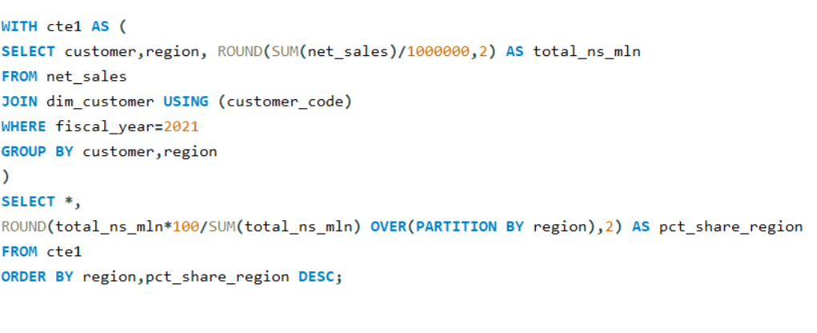
% OF Market SHARE by REGION BASED ON NET SALES
SQL Query
Output
PRESENTED BY IMRAN

Slide 14
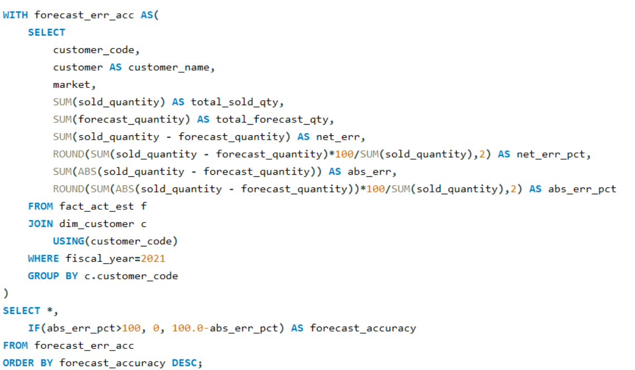
SUPPLY CHAIN – FORECAST ACCURACY – SQL QUERY
PRESENTED BY IMRAN

Slide 15
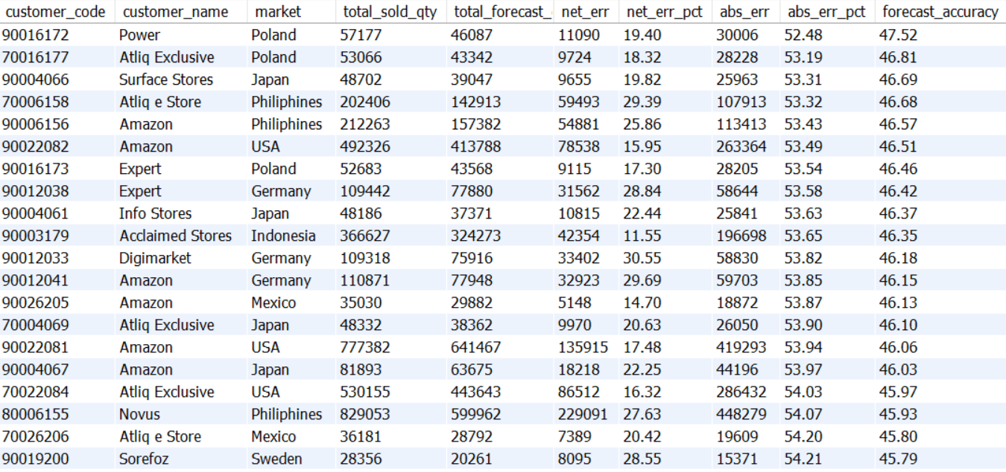
SUPPLY CHAIN – FORECAST ACCURACY – OUTPUT
PRESENTED BY IMRAN

Slide 16
CONCLUSION
Net sales of Amazon is highest with 109.03M in fiscal year 2021followed by AtliQ Exclusive with 79.92M.
Market in India generated maximum net sales with 210.67M in fiscal year 2021 followed by USA with 132.05M.
Amazon generated 13.23% of total net sales among all customers in fiscal year 2021.
In APAC region, Amazon contributed maximum net sales % of12.99 % among rest customers in 2021.
India secures the top spot in total gross sales within the APAC region.
PRESENTED BY IMRAN

